Slide 1


EMMETT: Extreme Meta-Classification for Large-Scale Zero-Shot Retrieval
RESEARCH
TRACK
Sachin Yadav*, Deepak Saini*, Anirudh Buvanesh*, Bhawna Paliwal, Kunal Dahiya, Siddarth Asokan, Yashoteja Prabhu, Jian Jiao, Manik Varma
Microsoft Research India
Notes:
Hi Everyone. I am Sachin Yadav from Microsoft Research Lab – India.
And I will be talking about our work “Extreme Meta-Classification for Large-Scale Zero-Shot Retrieval” where our goal is to develop solutions to generate accurate representations of novel (zero-shot) items without significant computational overhead in large-scale setting.

Slide 2






Large-Scale Retrieval
Retrieval of items relevant to a user query from a pool of hundreds of millions.
user query
set of items
Notes:
Starting with the setting of this work. In Large-Scale Retrieval, given a user query, the task is to retrieve the set of most relevant items from a pool of hundreds of millions of items.
To optimize user satisfaction, the retrieved items should be highly relevant to the query and delivered in real-time, typically within milliseconds.
There are multiple applications to this setting such as matching queries to advertisement keywords on Microsoft Bing, Tagging Wikipedia articles with suitable tags. But for this presentation, I will be using the running example of item recommendation on Amazon.

Slide 3
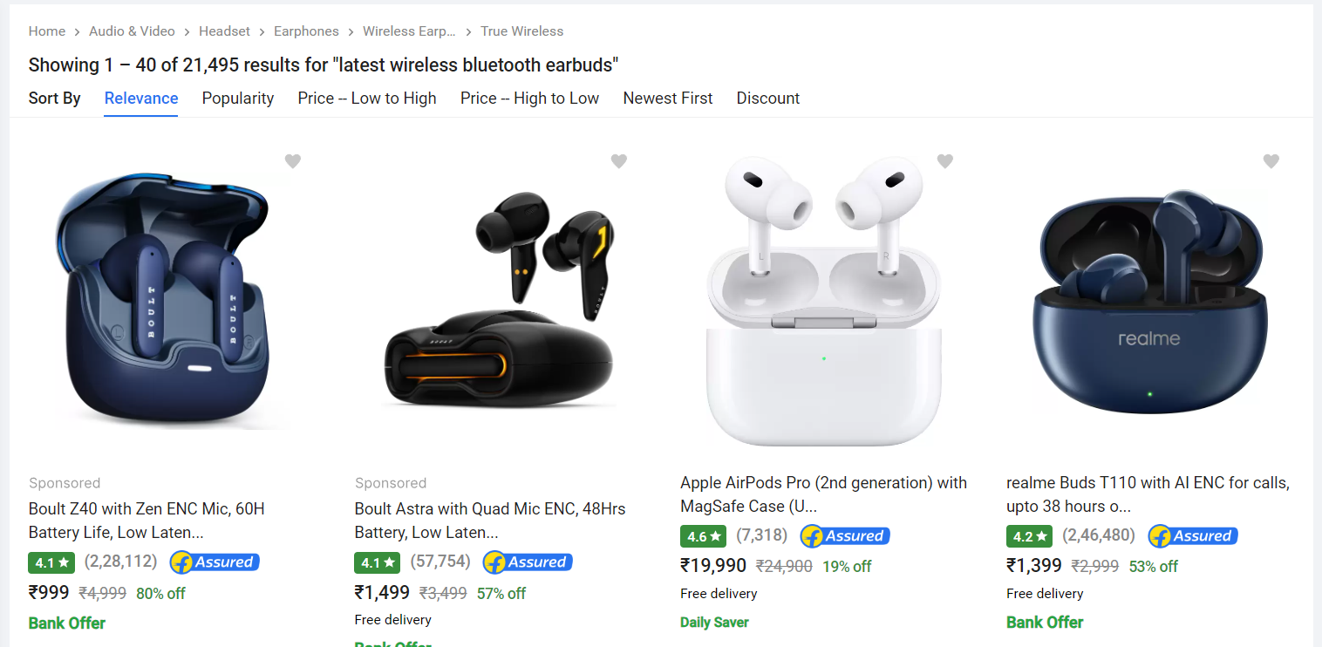

Product Recommendation
“latest wireless bluetooth earbuds”
Notes:
On Amazon, the example is simple, a user is looking for “latest wireless Bluetooth earbuds” and a list of recommendations from the website are shown here.
Now this example highlights two points, first on an e-commerce platform, new items in vast quantities keep on arriving at a rapid pace.
Second, understanding the intent of the user, these new items are crucial for user satisfaction.
These two aspects show why handling zero-shot items is such an important problem in large-scale retrieval.

Slide 4
Novel (Zero-Shot) Items
Goal: Efficient and Accurate Solutions for handling zero-shot items.
What we want in an ideal solution:
[Accuracy] 🎯 High Accuracy on both novel and observed items.
[Efficiency] 🚀 Low Retrieval Time
[Efficiency] 🚀 Low Representation time for new items
Notes:
So our goal is to develop efficient and accurate solutions for handling zero-shot items in large-scale retrieval settings.
But first we must establish, what are the features that we want in any solution that we develop.
First, is the high-quality of the predictions. Not only for retrieving from the index of novel items, but good accuracy for index of combined novel and observed items, we call this setting as generalized zero-shot setting. We don’t want a solution which presents a tradeoff in accuracy of novel and observed items.
Second the retrieval time is a major factor. We want to avoid a significant overhead in retrieval time, that is the time taken to generate predictions for a given query.
Third, the representation time. The time required to incorporate a new item into the index of items.

Slide 5
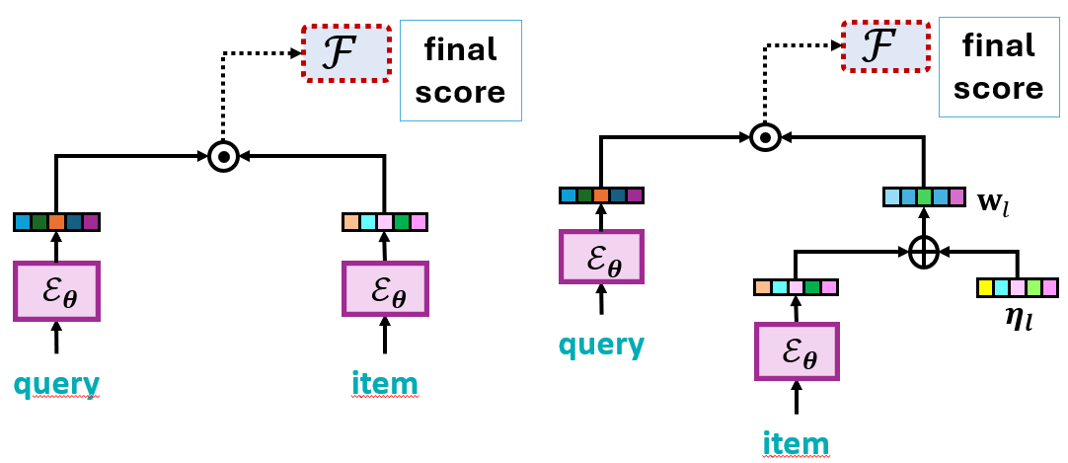
Previous Approaches
❔
 | Dense Retrieval | Extreme Classification | What we want!
Accuracy for Observed Items | ✔️ | ✔️✔️ | ✔️✔️
Accuracy for Novel Items | ✔️ | ❌ | ✔️✔️
Retrieval Time | ✔️✔️ | ✔️✔️ | ✔️✔️
Representation Time | ✔️✔️ | ❌ | ✔️✔️
Notes:
Here we measure previous approaches as per our desired features.
Widely used techniques include Dense Retrieval, where the query and items are represented as embeddings in a shared low-dimensional space such that items relevant to a query are positioned closer to it than the irrelevant ones.
Typical dense retrievers are based on Siamese Encoder architecture which uses a common neural encoder for both query and item representation. For efficiency, a small encoder is often utilized. However, a small encoder lacks the capacity to model the complexity inherent in retrieval tasks. For instance, product descriptions often contain named entities (brands), model numbers, and ambiguous phrases (example “Sony 1000XM4” which is a headphones brand). The small encoders don’t have the capacity to model this world knowledge.
A promising alternative is, Extreme Classification methods. Leading extreme classification approaches augment Siamese encoder with a linear classification layer, which significantly increase the model capacity. Every observed item is trained with its own extra-capacity classifier which absorbs world knowledge for that particular item when trained with historical logs.
When enough query-item pairs are available, these per-item classifiers provide a more precise representation.
However, zero-shot items, since no training data is available, no classifiers can be trained for a more precise representation.
We are looking for a solution which shines in all these four aspects.

Slide 6
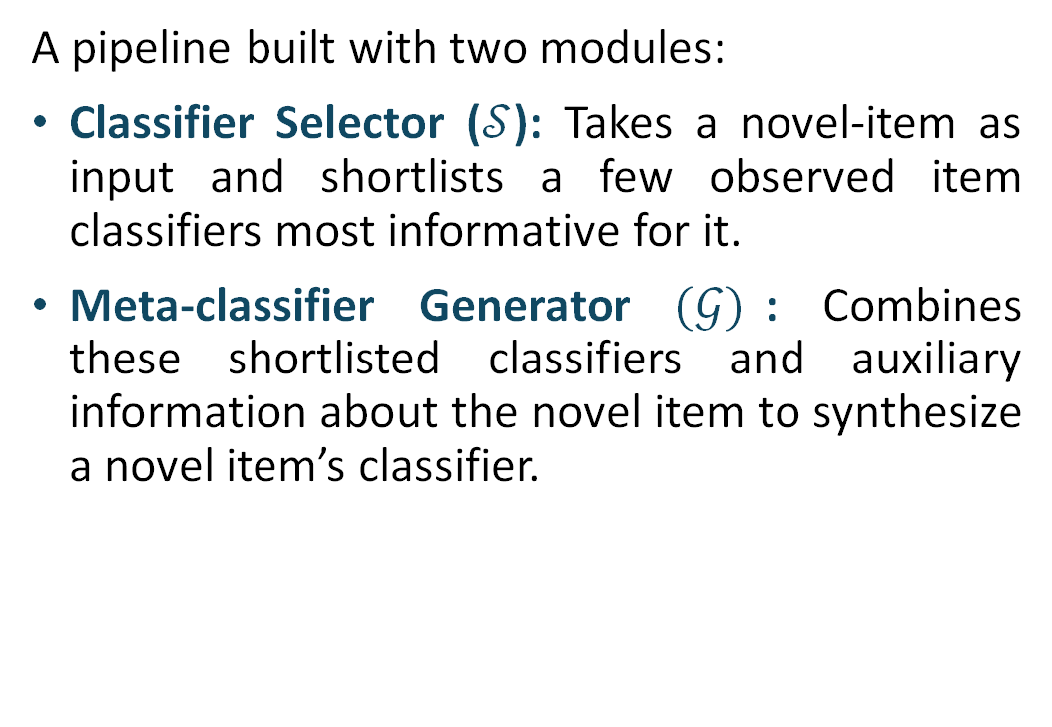
EMMETT: ExtreMe MEta-ClassificaTion
A pipeline built with two modules:
Classifier Selector ($𝒮$): Takes a novel-item as input and shortlists a few observed item classifiers most informative for it.
Meta-classifier Generator $(𝒢)$: Combines these shortlisted classifiers and auxiliary information about the novel item to synthesize a novel item’s classifier.
Notes:
Addressing the limitations of previous methods, we present “EMMETT: Extreme Meta-Classification” Framework.
EMMETT as a framework extends the conventional extreme classification to zero-shot scenarios.
There are two key insights that underpin EMMETT:
First, In a large-scale setting with millions of items, and a classifier per-item, these millions of classifiers are likely to contain most of the world-knowledge required for a novel item in distilled form. These observed items contain useful information for a novel item, so first we need a method, given a new item, find classifiers which contain information useful for this item.
Using this, we design EMMETT as a pipeline of two modules,
A Classifier Selector that takes a novel item and shortlists the observed item classifiers most informative for it.
Then using these shortlisted observed item classifiers and novel item’s information in form of raw text or any other auxiliary information, another module, Meta-Classifier Generator synthesizes its meta-classifiers
To train this meta-classifier generator and classifier-selector, our second intuition comes into picture, which is feasible in large-scale retrieval. The hundreds of millions of observed items in training data act as samples to optimally train the EMMETT modules.
The figure presents the architectural overview of EMMETT. EMMETT is a generic framework where different choices of the two modules yields different algorithms with varying accuracy and efficiency trade-offs, which also provides opportunities for future research.

Slide 7
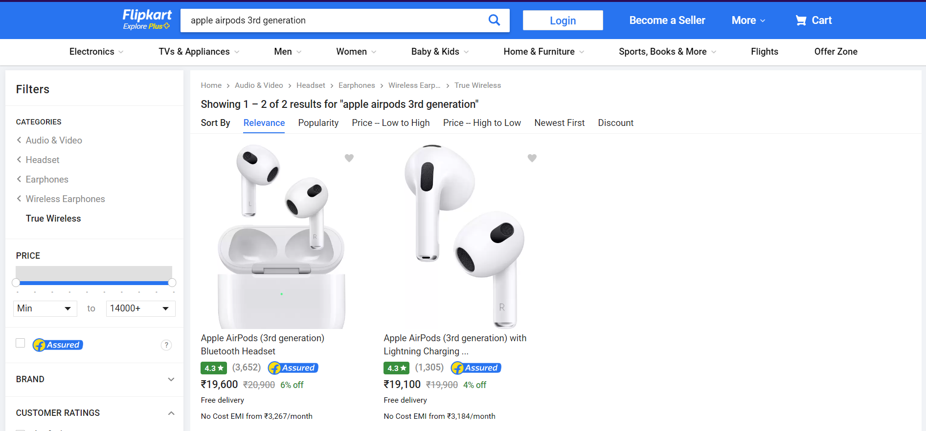

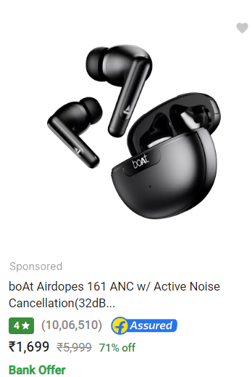

Classifier Selector
Selected classifiers of seen items
Notes:
So continuing with our running example where a user is looking for “latest wireless Bluetooth earbuds”.
In this e-commerce platform, A new item, a newer model of Apple Airpods “Apple Airpods (3rd gen)” has arrived in the market.
So the EMMETT pipeline starts.
First, with “Classifier Selector” module.
Given the description of the novel item, the classifier selector module, out of the hundreds of millions of observed items, selected a few most informative items for the novel item. For Apple Airpods 3rd generation, these might be other Apple music products and earbuds from other brands.
For classifier selector, one could use a cross-encoder, large language model or a nearest neighbor search based on their design choices.

Slide 8

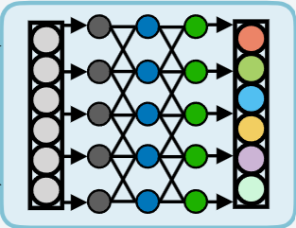
Meta-classifier Generator
Meta-Classifier of the novel item
Notes:
Now, once the most informative observed items for a novel item have been retrieved, next comes the meta-classifier generator module.
Given the novel item’s information, that is its description.
And, the shortlisted classifiers as inputs, the meta-classifier generator synthesizes a meta-classifier for the novel item.
Again, this meta-classifier generator can be as simple model as a linear sum or a learnt function as a trained model.

Slide 9

Generalization Performance of EMMETT
Theorem: Let $R$and$\hat{R}$ be the true and empirical risk, and ${\hat{ℛ}}_{s}$be the empirical Rademacher complexity over the set $𝒮$ of query-item pairs. Let $p≪1$ be the probability of a positively related query-item pair, and $q$ be the probability that $𝒮 (\left|𝒮\right|=M)$ has at most $κ$ positive pairs. Then, $w.p. \left(1−δ\right)$:
$R≤\hat{R}+{\hat{ℛ}}_{s}+3\left( q+\frac{\sqrt{\ln\left(\frac{2}{δ−2q}\right)}}{2M}\right)$ , where $q=\exp\left\{−2M\left(1−p−\frac{κ}{M}\right)\right\}$
Insights:
The generalization gap is inversely related to the dataset size (i.e., # of items).
The large-scale setting improves zero-shot learning.
Simpler meta-classifiers (smaller ${\hat{ℛ}}_{s}$) yield superior generalization.
Notes:
On theoretical analysis of such a framework, there are few takeaways:
First, the generalization performance is related to the size of the observed item (denoted by M). The large-scale setting where we have hundreds of millions of items in observed set, helps to generalize better.
Second, a simpler meta-classifier generator yields better generalization. Where the complexity of the model is denoted by R_subscript S in this equation.

Slide 10
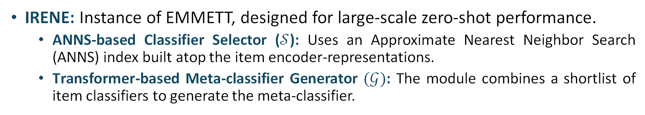
IRENE Algorithm
IRENE: Instance of EMMETT, designed for large-scale zero-shot performance.
ANNS-based Classifier Selector ($𝒮$): Uses an Approximate Nearest Neighbor Search (ANNS) index built atop the item encoder-representations.
Transformer-based Meta-classifier Generator $(𝒢)$: The module combines a shortlist of item classifiers to generate the meta-classifier.
Notes:
Now each choice of the Classifier Selector and Meta-Classifier generator leads to a different algorithm based on the application requirements.
So we went ahead and carefully designed an algorithm as per our requirement, keeping accuracy and efficiency in large-scale retrieval with its strict latency constraints as the criteria.
As Classifier Selector, we choose a simple Nearest Neighbor Search on top of item encoder representations. Already a ton of efficient methods such as DiskANN that have been designed for approx. near neighbor search.
For Meta-Classifier Generator, we train a single-layer transformer-based encoder module. Training such a model is feasible because the observed items act as training samples for this model.
The key aspect of our algorithm is its scalability aspect, we test its scalability to the size of Microsoft Bing where it serves millions of user queries each day.

Slide 11

Rademacher Complexity of IRENE
Lemma: Let $ℱ$ be the class of functions defined in the IRENE algorithm, comprising pre-determined encoder representations and classifiers, a given classifier selector that outputs $K$ classifiers, and $G$, the meta-classifier generator. Let $M$ be the weight matrix of the linear layer and $\max_{x}\left({\left|\left|x\right|\right|}_{2}\right)=B$. Then, the Rademacher complexity of $ℱ$ can be bounded as follow:
$${\hat{ℛ}}_{s}\left(ℱ\right)≤𝒪\left(B{\left|\left|M\right|\right|}_{2}\sqrt{d ln⁡(K+1) }\right)$$
Rademacher complexity of IRENE meta-classifier improves with smaller $K$:
Combining $K≈3$ seen classifiers yields better generalization!
Analysis for XC classifiers and IRENE with trainable classifier in the paper!
Notes:
On theoretical analysis of such an algorithm, we have answer to few of questions.
First, given a novel items, how many observed item classifiers should I combine.
For better generalization, choose K, the number of observed items to be small, around 3.
For all remaining questions, on how to train and whether to train meta-classifier and classifiers jointly or not. Do check our full paper.

Slide 12
Evaluation on Benchmark Datasets
Up to 39% improvement in zero-shot and 29% improvement in the generalized setting.
Zero-shot performance
Generalized performance
P@1
LF-AOL-270K
Encoder
Encoder + IRENE
P@1
LF-WikiHierarchy-550K
Notes:
Coming to Results.
On benchmark datasets, we see significant gains for zero-shot performance and generalized zero-shot performance.
Zero-shot evaluation is the setting, where only the novel items are in the index for predictions and generalized when both observed and novel items are in the index.
This ticks our first two desired traits, that we want to improve accuracy of novel items but not as a tradeoff for accuracy of observed item. We want significant performance gains on both zero-shot and generalized setting.
Also, as shown in the charts, IRENE algorithm can be applied with different base Siamese encoders and shows significant improvement in all cases, showing the adaptability of such algorithm.

Slide 13
Additional Results
IRENE can be Adapted seamlessly to one-shot or few-shot.
Baseline NGAME-OneShot is retrained on the revealed data.
IRENE out-performs baseline NGAME-OneShot by 1-2% without any additional training overhead.
P@1
Notes:
Not only on zero-shot setting and generalized zero-shot setting, IRENE is also adaptable to one-shot or few-shot scenario.
Understand this setting as this, a novel items arrives in our system, that’s a zero-shot item, but after a time, we log user interactions in form of clicks on these items, these items are termed as one-shot or few-shot.
Can we utilize these registered clicks (the one or few datapoint) without again training the model.
The answer is Yes.
We do compare IRENE-one-shot with different baselines.
There’s also a baseline, NGAME-OneShot where the model is full re-trained.

Slide 14
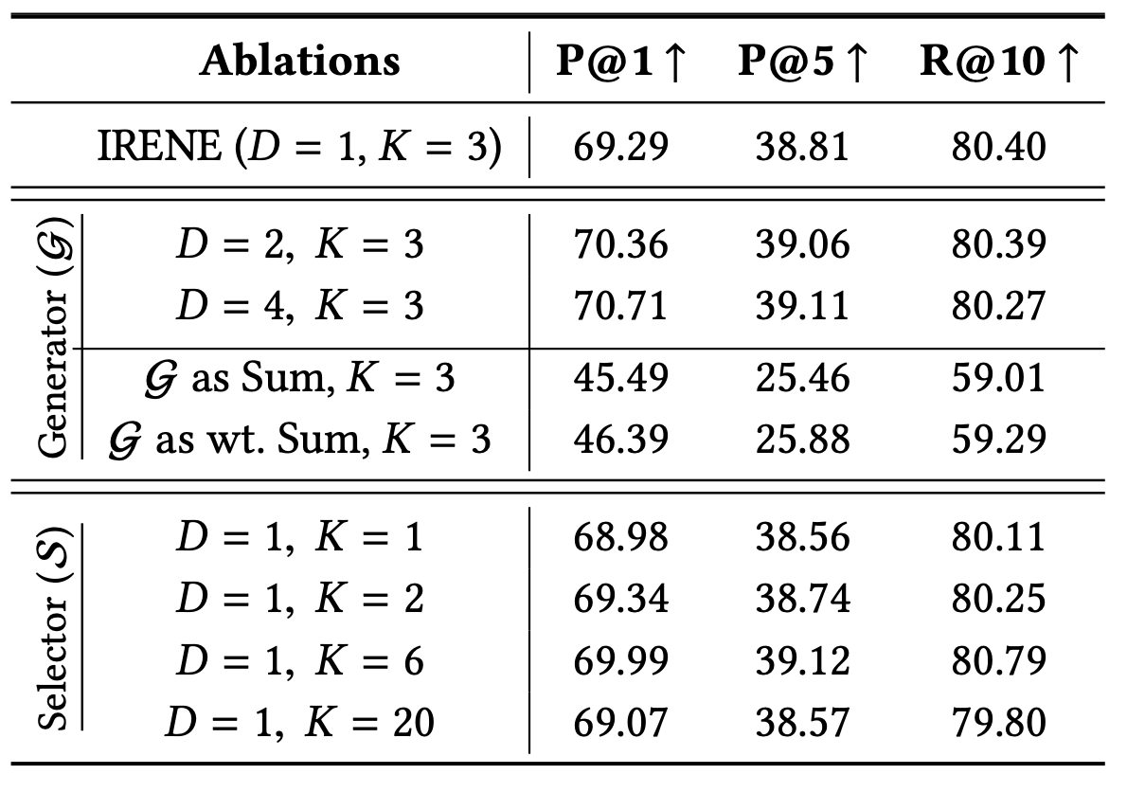
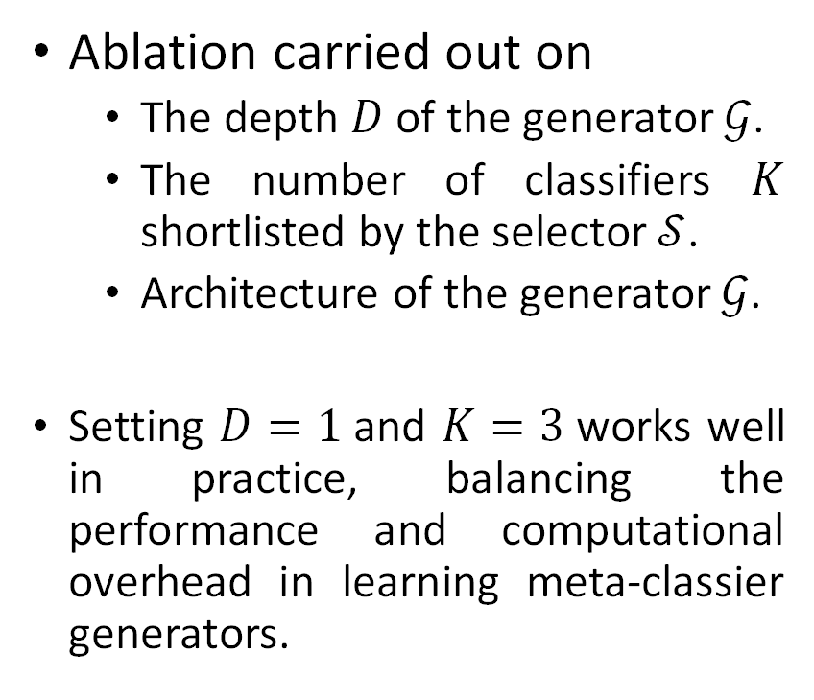
Ablations
Ablation carried out on
The depth $D$ of the generator $𝒢$.
The number of classifiers $K$ shortlisted by the selector $𝒮$.
Architecture of the generator $𝒢$.
Setting $D=1$and $K=3$works well in practice, balancing the performance and computational overhead in learning meta-classier generators.

Slide 15
Real-world Deployment
We conducted A/B testing on Microsoft Bing to match user queries with advertisement keywords.
IRENE boosted the click-through rate by 4.2% and improved prediction quality by 9%, according to expert evaluations.
IRENE encodes a novel keyword in under 1 millisecond!
Notes:
To test the scalability of the IRENE algorithm, we deploy it on Microsoft Bing Search where it was used to match the user queries to the advertisement keywords.
Not only IRENE scaled efficiently to such a massive scale, it also shows gains in online metrics which is significant by a 4.2% boost in the click-through-rate.
On expert evaluation – human annotation and language models, IRENE predictions were found to be 9% higher quality than the baseline.
And with this, it encodes a given novel item within 1 millisecond with no overhead in search retrieval time.
In conclusion, IRENE ticks all the four criteria. It shows superior online performance, and is efficient to such scale.

Slide 16
Conclusions
We studied large-scale zero-shot retrieval and developed techniques to efficiently and accurately represent novel items.
We proposed EMMETT, a generic algorithmic framework for learning accurate meta-classifiers for novel items that ellucidates accuracy versus efficiency trade-offs.
We proposed IRENE, a novel, practically deployable algorithm to boost the zero-shot performance of any Siamese encoder.
IRENE atop leading encoders improves the zero-shot retrieval accuracy by up to 15% points, and improves the ad click-through rate by 4.2%.
Notes:
conclusions.
We discussed the our ongoing research in handling zero-shot items in large-scale retrieval and the current requirements in any solution we develop.
Understanding this, we propose a generic framework EMMETT for learning accurate meta-classifiers with different design choices demonstrating accuracy vs efficiency trade-offs.
We propose IRENE, a practically deployable algorithm to boost zero-shot performance of any Siamese Encoder.
IRENE shows significant gains on benchmarks and improves the click-through-rate by 4.2% in online real-world deployments.

Slide 17

EMMETT: Extreme Meta-Classification for Large-Scale Zero-Shot Retrieval
RESEARCH
TRACK
Scan for more details!
Notes:
Due to the time constraint, we could not cover a number of interesting observations and results in this presentation.
For a more in-depth discussion and our findings, please do check out our full paper.
Thank you.

